Slide 2
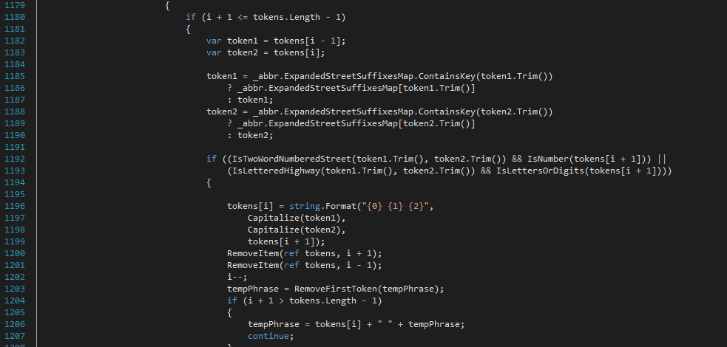

Slide 3
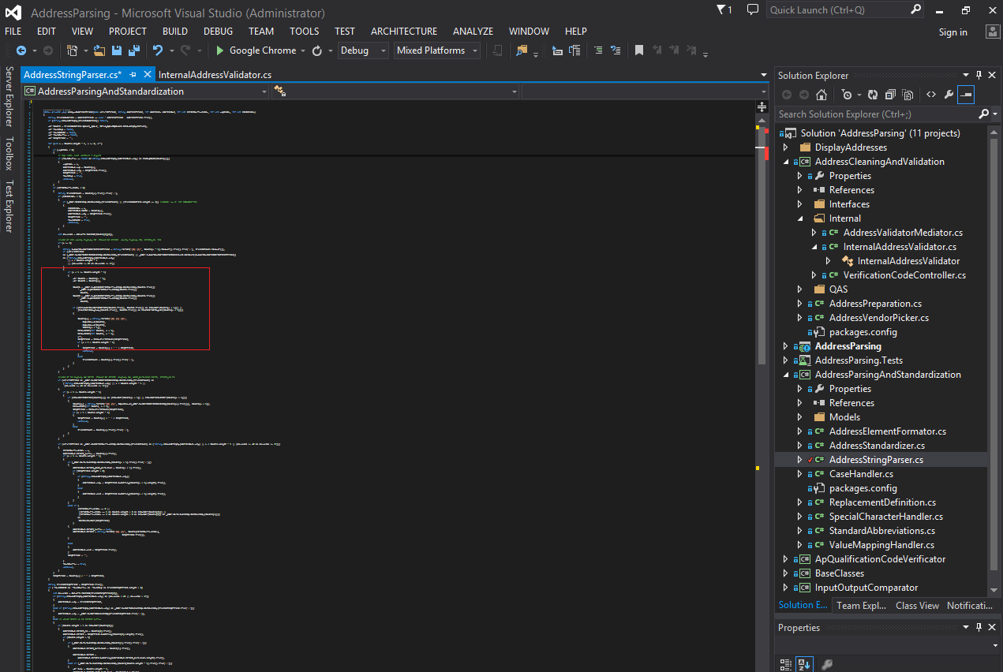

Slide 4
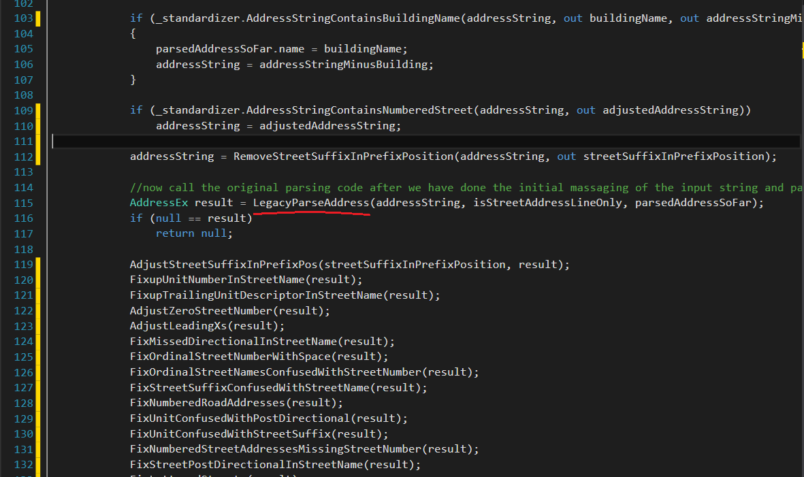

Slide 5
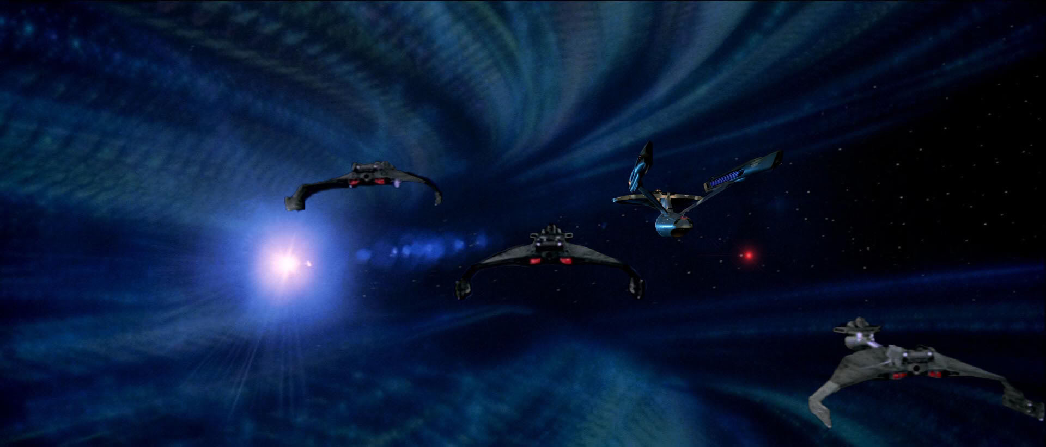

Slide 6
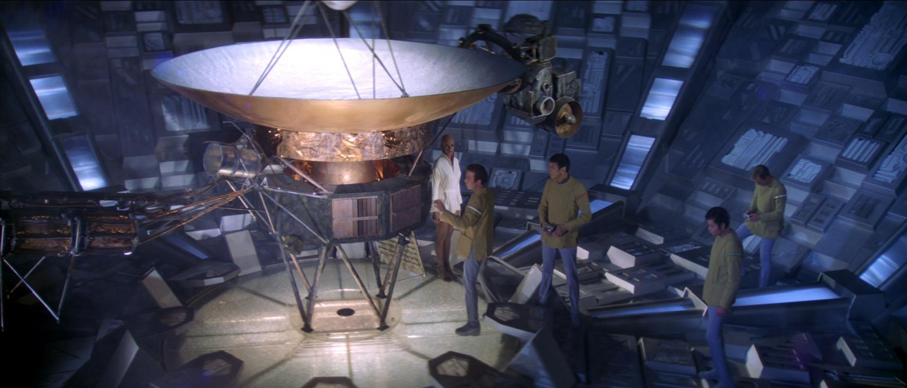

Slide 7
Pre-cleanse Address String
Pre-cleanse Address String
Pre-cleanse Address String
Pre-cleanse Address String
…
Call Legacy Address Parser()
Post-fixup Parse Results
Post-fixup Parse Results
Post-fixup Parse Results
Post-fixup Parse Results
…

Slide 8
“321 Mercer St, Seattle, WA 98109”
Address Patterns Definition
(DSL)
Mercer
Seattle
321
WA
9809
St
Tokenize
Match
Pattern Expansion

Slide 9
“321 Mercer St, Seattle, WA 98109”
Address Patterns Definition
(DSL)
Mercer
Seattle
321
WA
9809
St
Tokenize
Match
100
Pattern Expansion
Score
80
Heuristics
Property
Address
Solr
Street
Solr

Slide 10
“321 Mercer St, Seattle, WA 98109”
Address Patterns Definition
(DSL)
Mercer
Seattle
321
WA
9809
St
Tokenize
Match
100
Pattern Expansion
Score
80
Heuristics
Property
Address
Solr
Street
Solr

